Slide 1

Advanced Corporate Finance (LL4554V/LL5554V/LLJ5554V/LL6554V) 7. Risk & Return II: the cost of capital
Kenneth Khoo
kenneth.khoo@nus.edu.sg

Slide 2

Investment criteria
The Asset Cost of Capital
Types of Risk
How Financial Risk Affects the Cost of Equity
Project Costs of Capital
Comparable Companies Analysis
Analyzing Project Risk

Slide 3
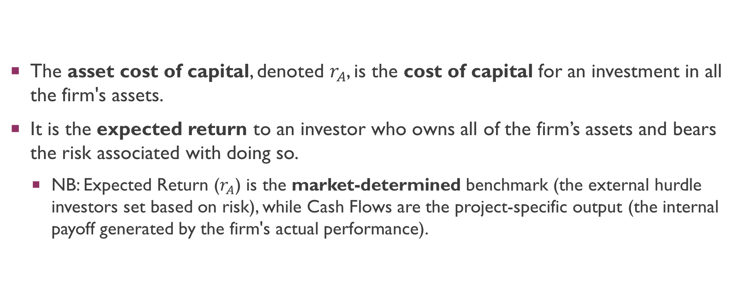
The asset cost of capital
The asset cost of capital, denoted $r_{A}$, is the cost of capital for an investment in all the firm's assets.
It is the expected return to an investor who owns all of the firm’s assets and bears the risk associated with doing so.
NB: Expected Return ($r_{A}$) is the market-determined benchmark (the external hurdle investors set based on risk), while Cash Flows are the project-specific output (the internal payoff generated by the firm's actual performance).

Slide 4
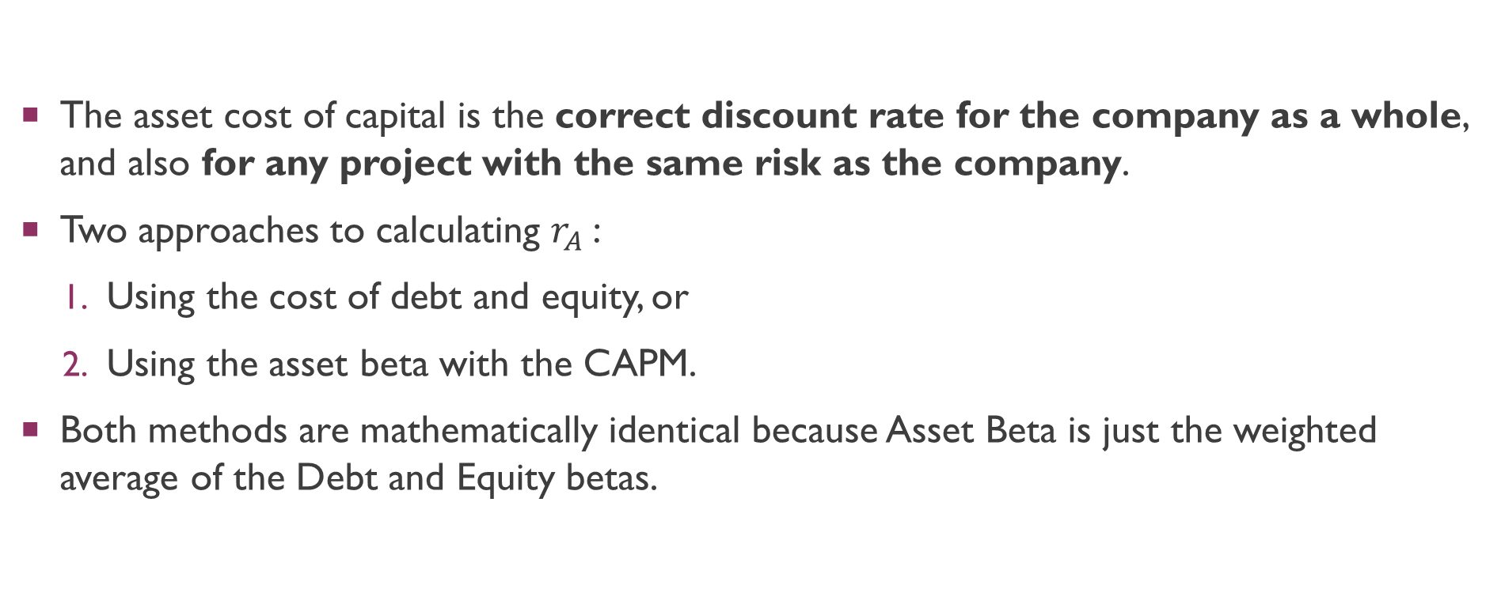
The asset cost of capital
The asset cost of capital is the correct discount rate for the company as a whole, and also for any project with the same risk as the company.
Two approaches to calculating $r_{A}$:
Using the cost of debt and equity, or
Using the asset beta with the CAPM.
Both methods are mathematically identical because Asset Beta is just the weighted average of the Debt and Equity betas.

Slide 5
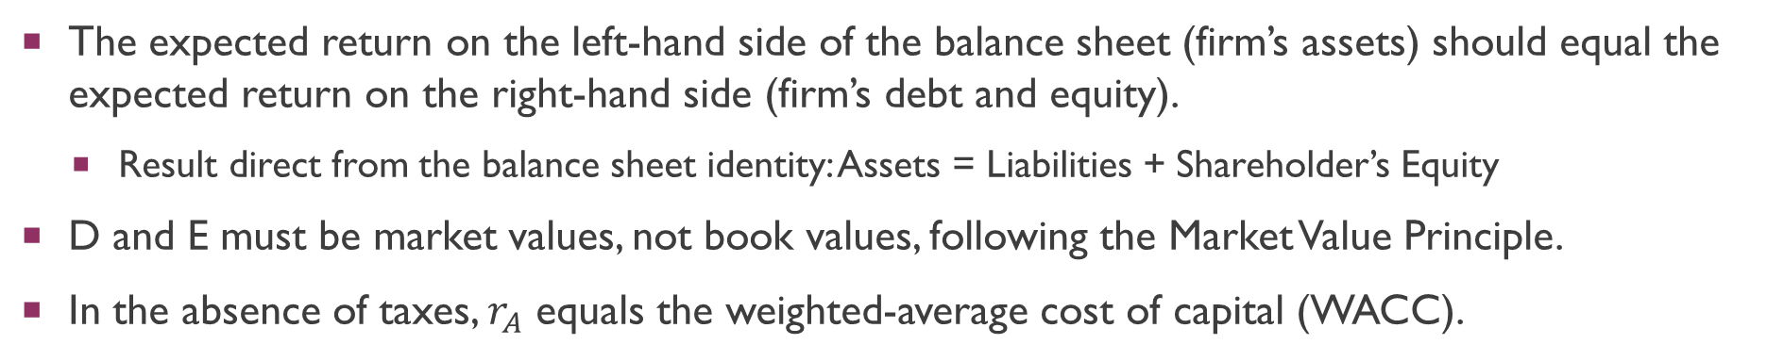
The asset cost of capital
The equation for the asset cost of capital is:
The expected return on the left-hand side of the balance sheet (firm’s assets) should equal the expected return on the right-hand side (firm’s debt and equity).
Result direct from the balance sheet identity: Assets = Liabilities + Shareholder’s Equity
D and E must be market values, not book values, following the Market Value Principle.
In the absence of taxes, $r_{A}$ equals the weighted-average cost of capital (WACC).
Notes:
r_A is the return the assets must generate to be viable.
WACC is the hurdle rate we use for discounting, which is lower because the government subsidizes debt financing.

Slide 6
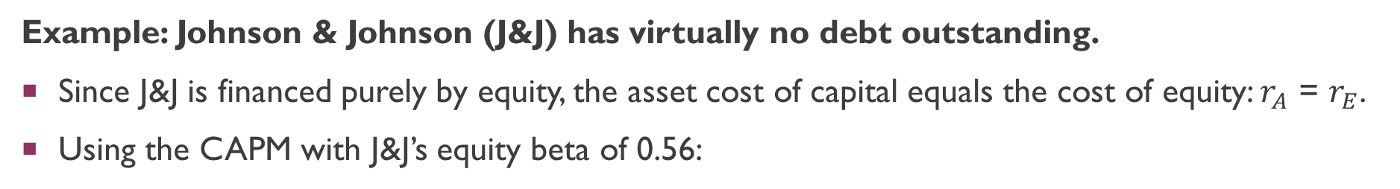
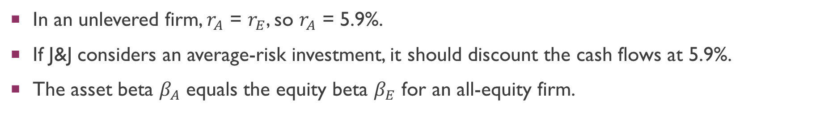
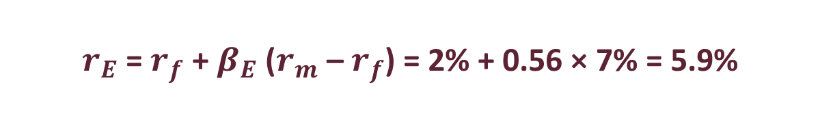
THE ASSET COST OF CAPITAL: UNLEVERED FIRM
Example: Johnson & Johnson (J&J) has virtually no debt outstanding.
Since J&J is financed purely by equity, the asset cost of capital equals the cost of equity: $r_{A}$ = $r_{E}$.
Using the CAPM with J&J’s equity beta of 0.56:
$r_{E}$ = $r_{f}$ + $β_{E}$ ($r_{m}$ – $r_{f}$) = 2% + 0.56 × 7% = 5.9%
In an unlevered firm, $r_{A}$ = $r_{E}$, so $r_{A}$ = 5.9%.
If J&J considers an average-risk investment, it should discount the cash flows at 5.9%.
The asset beta $β_{A}$ equals the equity beta $β_{E}$ for an all-equity firm.

Slide 7
THE ASSET COST OF CAPITAL: LEVERED FIRM
Example: CSX (railroad) has both debt and equity.
CSX Balance Sheet
Assets: A = $86B | Debt: D = $17B (20%) rD = 3.4%
Total: V = $86B | Equity: E = $69B (80%) rE = 10.7%
Cost of equity (CAPM): $r_{E}$ = 2% + 1.24 × 7% = 10.7%
Asset cost of capital:
$r_{A}$ = $r_{D}$(D/V) + $r_{E}$(E/V) = 3.4 × 0.20 + 10.7 × 0.80 = 9.2%

Slide 8
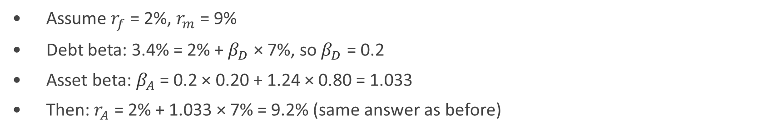



WACC AND ASSET BETA
WACC (No Taxes)
Asset Beta
WACC = $r_{D}$(D/V) + $r_{E}$(E/V)
$β_{A}$ = $β_{D}$(D/V) + $β_{E}$(E/V)
$β_{D}$ = debt beta (sensitivity of
debt return to the market)
Without taxes, WACC = $r_{A}$
CSX Example:
Assume $r_{f}$ = 2%, $r_{m}$ = 9%
Debt beta: 3.4% = 2% + $β_{D}$ × 7%, so $β_{D}$ = 0.2
Asset beta: $β_{A}$ = 0.2 × 0.20 + 1.24 × 0.80 = 1.033
Then: $r_{A}$ = 2% + 1.033 × 7% = 9.2% (same answer as before)
Notes:
NB: If 𝑟_𝐷 not given, you may infer it from YTM on bonds.

Slide 9
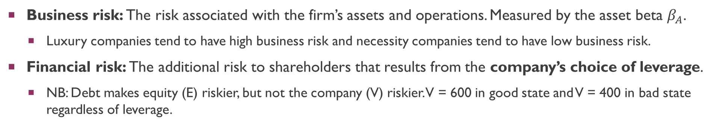
Types of risk
Business risk: The risk associated with the firm’s assets and operations. Measured by the asset beta $β_{A}$.
Luxury companies tend to have high business risk and necessity companies tend to have low business risk.
Financial risk: The additional risk to shareholders that results from the company’s choice of leverage.
NB: Debt makes equity (E) riskier, but not the company (V) riskier. V = 600 in good state and V = 400 in bad state regardless of leverage.
Firm A (Unlevered)
Firm B (Levered: 80% Debt)
V = 500, D = 0, E = 500
Good state: E = 600 (+20%)
Bad state: E = 400 (–20%)
Shareholders bear only business risk
V = 500, D = 400, E = 100
Good state: E = 200 (+100%)
Bad state: E = 0 (–100%)
Leverage magnifies business risk

Slide 10
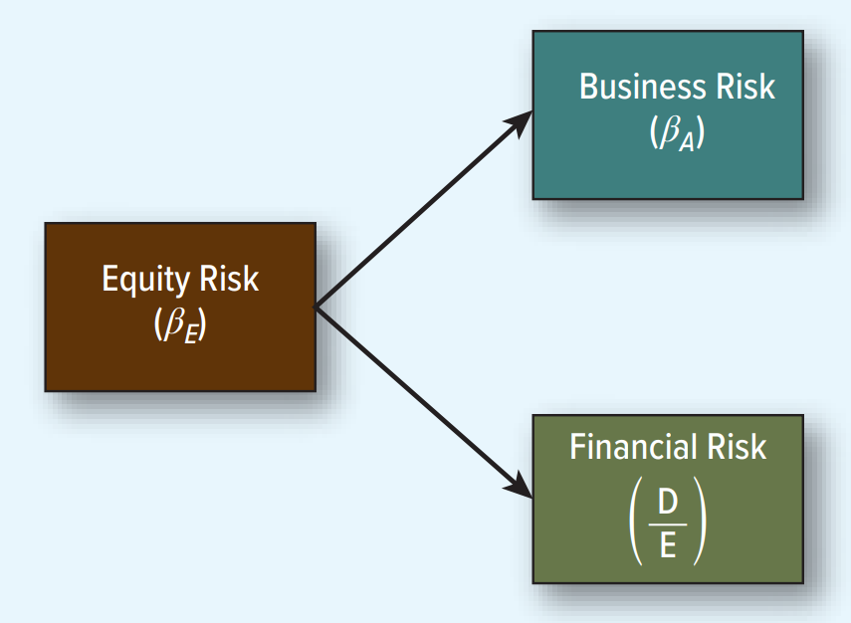
Types of risk
Shareholders bear two sources of risk: Business risk and financial risk.

Slide 11
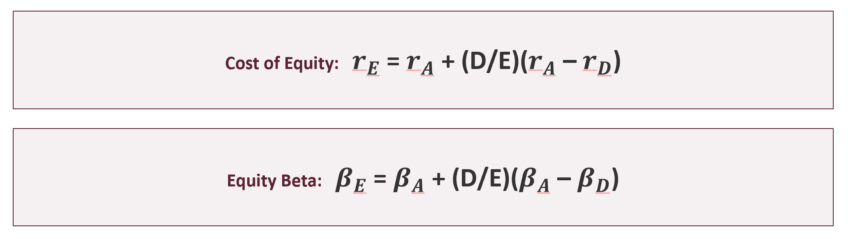
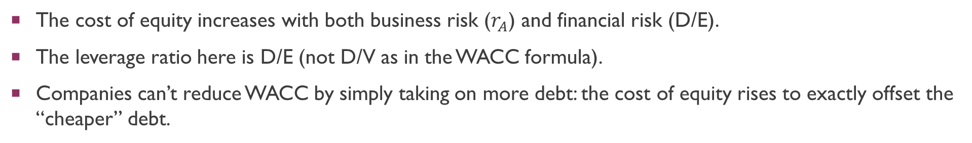
HOW FINANCIAL RISK AFFECTS THE COST OF EQUITY
The cost of equity increases with both business risk ($r_{A}$) and financial risk (D/E).
The leverage ratio here is D/E (not D/V as in the WACC formula).
Companies can’t reduce WACC by simply taking on more debt: the cost of equity rises to exactly offset the “cheaper” debt.

Slide 12

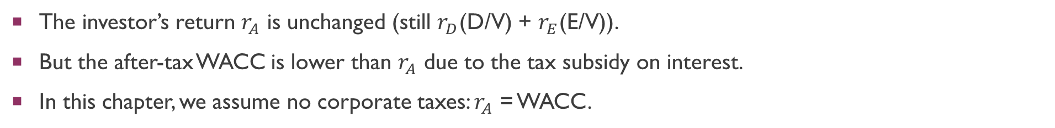
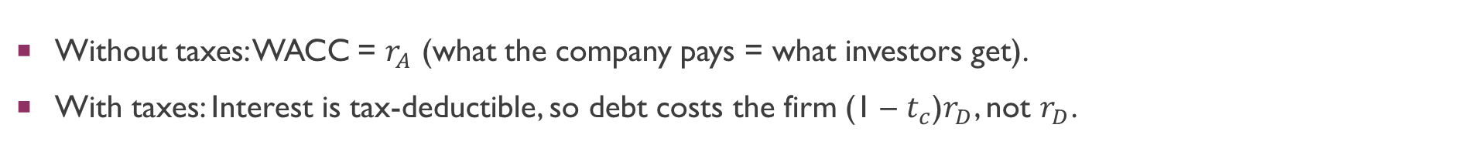
THE EFFECT OF CORPORATE TAXES
Without taxes: WACC = $r_{A}$ (what the company pays = what investors get).
With taxes: Interest is tax-deductible, so debt costs the firm (1 – $t_{c}$)$r_{D}$, not $r_{D}$.
The investor’s return $r_{A}$ is unchanged (still $r_{D}$(D/V) + $r_{E}$(E/V)).
But the after-tax WACC is lower than $r_{A}$ due to the tax subsidy on interest.
In this chapter, we assume no corporate taxes: $r_{A}$ = WACC.

Slide 13
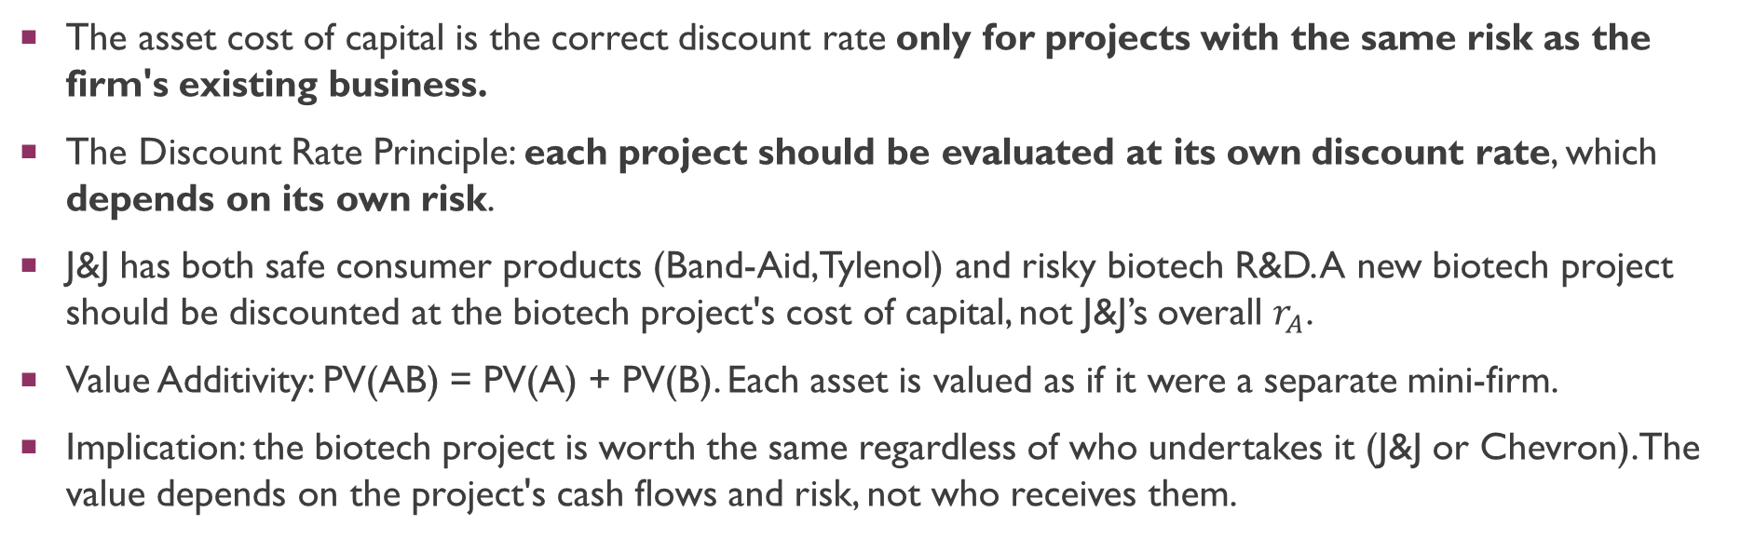
PROJECT COSTS OF CAPITAL
The asset cost of capital is the correct discount rate only for projects with the same risk as the firm's existing business.
The Discount Rate Principle: each project should be evaluated at its own discount rate, which depends on its own risk.
J&J has both safe consumer products (Band-Aid, Tylenol) and risky biotech R&D. A new biotech project should be discounted at the biotech project's cost of capital, not J&J’s overall $r_{A}$.
Value Additivity: PV(AB) = PV(A) + PV(B). Each asset is valued as if it were a separate mini-firm.
Implication: the biotech project is worth the same regardless of who undertakes it (J&J or Chevron). The value depends on the project's cash flows and risk, not who receives them.

Slide 14
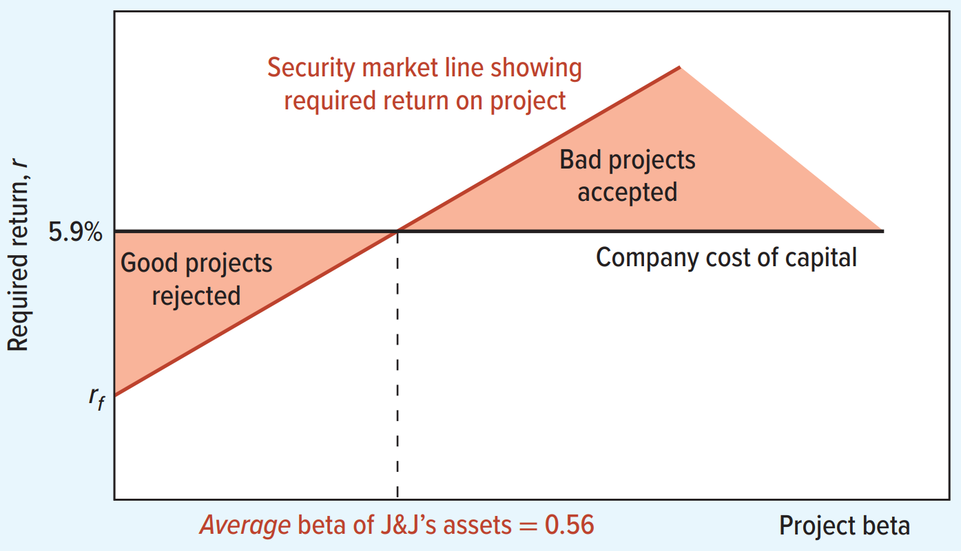
PROJECT COSTS OF CAPITAL
Using a single company-wide discount rate for all projects leads to errors:
Too low a discount rate for high-risk projects (accept bad projects).
Too high a discount rate for low-risk projects (reject good projects).

Slide 15
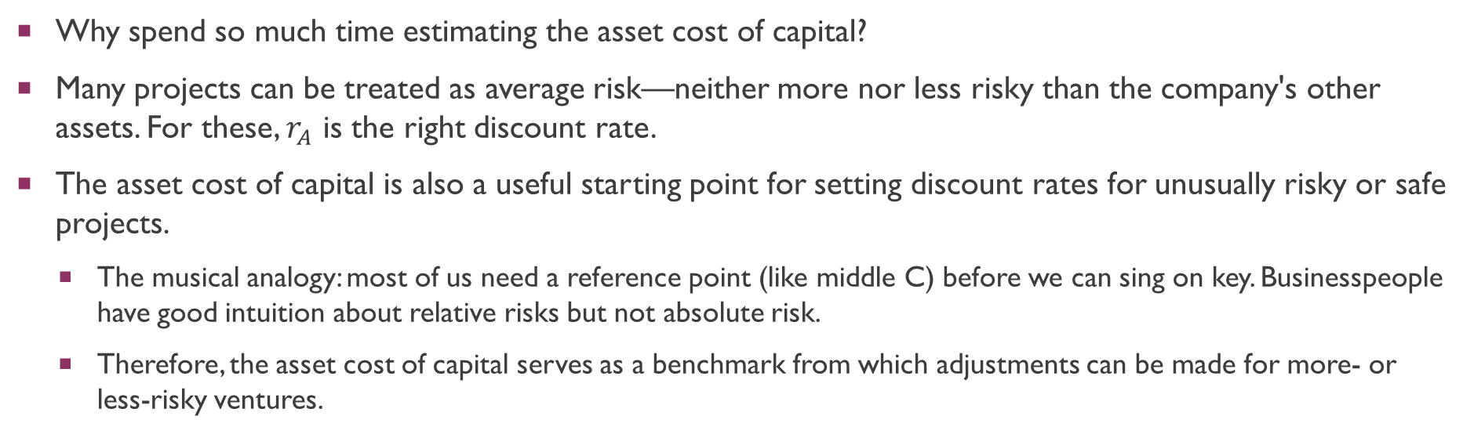
PROJECT COSTS OF CAPITAL
Why spend so much time estimating the asset cost of capital?
Many projects can be treated as average risk—neither more nor less risky than the company's other assets. For these, $r_{A}$ is the right discount rate.
The asset cost of capital is also a useful starting point for setting discount rates for unusually risky or safe projects.
The musical analogy: most of us need a reference point (like middle C) before we can sing on key. Businesspeople have good intuition about relative risks but not absolute risk.
Therefore, the asset cost of capital serves as a benchmark from which adjustments can be made for more- or less-risky ventures.

Slide 16
Comparable Companies Analysis
How do we estimate a project’s beta?
Use comparable companies analysis: to find a pure-play publicly traded company in the same line of business as your project.
Pure-play companies are firms that specialize in one activity, so their beta reflects only that activity’s risk.
Examples:
J&J’s pharmaceutical division: use average beta of pure-play pharmaceutical companies.
CSX investing in a new headquarters: use beta of commercial REITs (real estate investment trusts).
Key step: Unlever the comparable company’s equity beta to strip out financial risk, leaving only business risk.

Slide 17
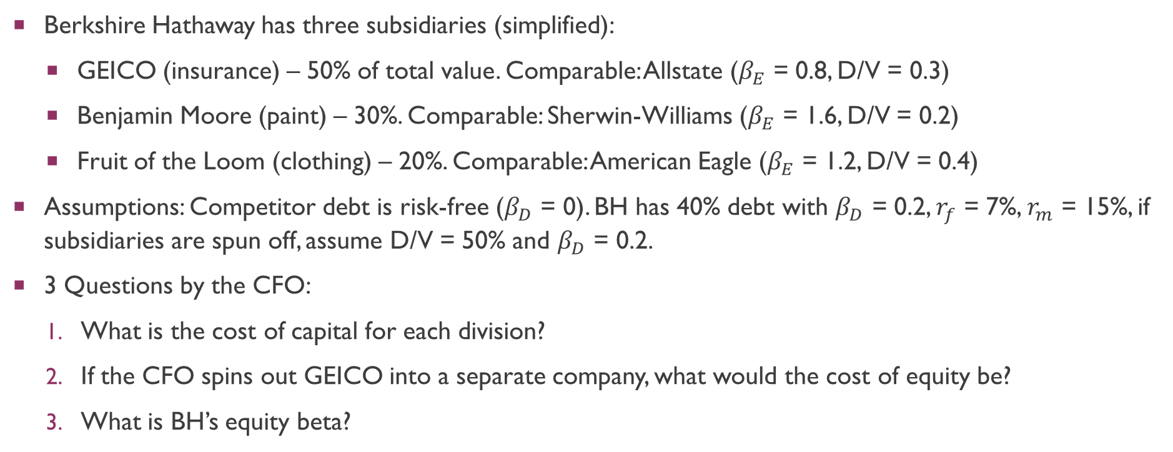
Comparable Companies Analysis
Berkshire Hathaway has three subsidiaries (simplified):
GEICO (insurance) – 50% of total value. Comparable: Allstate ($β_{E}$ = 0.8, D/V = 0.3)
Benjamin Moore (paint) – 30%. Comparable: Sherwin-Williams ($β_{E}$ = 1.6, D/V = 0.2)
Fruit of the Loom (clothing) – 20%. Comparable: American Eagle ($β_{E}$ = 1.2, D/V = 0.4)
Assumptions: Competitor debt is risk-free ($β_{D}$ = 0). BH has 40% debt with $β_{D}$ = 0.2, $r_{f}$ = 7%, $r_{m}$ = 15%, if subsidiaries are spun off, assume D/V = 50% and $β_{D}$ = 0.2.
3 Questions by the CFO:
What is the cost of capital for each division?
If the CFO spins out GEICO into a separate company, what would the cost of equity be?
What is BH’s equity beta?

Slide 18
Comparable Companies Analysis
Q1: Un-lever each comparable’s equity beta to get asset betas and then compute $r_{A}$using CAPM.
Comparable | βE | E/V | βA = βE × E/V | rA (CAPM)
Allstate (GEICO) | 0.80 | 0.70 | 0.56 | 11.48%
Sherwin-Williams (Benjamin Moore) | 1.60 | 0.80 | 1.28 | 17.24%
American Eagle (Fruit of the Loom) | 1.20 | 0.60 | 0.72 | 12.76%

Slide 19


Comparable Companies Analysis
Q2: GEICO’s cost of equity if spun off (D/V = 50%, βD = 0.2) (re-lever):
Q3: Berkshire Hathaway's equity beta (re-lever):
Sense Check: The asset beta (0.81) is always less than the equity beta (1.22), because the asset beta measures only business risk while the equity beta measures both business and financial risk.
Notes:
Cost of capital and asset betas measure only business risk, not financial risk.

Slide 20
Analyzing Project Risk
How can you make informed judgments about costs of capital for projects or lines of business when you suspect that risk is not average, or for which there are no pure-play comparables?
Think about the determinants of asset betas
Think about what drives the project's systematic risk: cyclicality, operating leverage, and duration of cash flows.
Ignore diversifiable risk.
Diversifiable risk affects expected cash flows, not the discount rate. The cost of capital depends only on systematic risk.
Avoid fudge factors in discount rates
Don't add arbitrary fudge factors to the discount rate. Adjust expected cash-flow forecasts instead.

Slide 21
determinants of asset betas
One factor that affects the asset beta is the cyclicality of a project’s revenues.
Projects whose revenues are strongly dependent on the state of the business cycle tend to be high-beta firms.
Cyclical: airlines, luxury goods, travel, construction. Less cyclical: food, utilities, consumer staples.
Another factor is the operating leverage (ratio of fixed costs to variable costs).
Cash flow = Revenue – Fixed costs – Variable costs.
High fixed costs relative to variable costs means high operating leverage: large revenue changes translate into even larger cash flow changes, increasing beta.

Slide 22
determinants of asset betas
A final factor is the discount rate risk.
Long-term cash flows are more exposed to shifts in discount rates (similar to long-duration bonds).
A project with very long-term cash flows will have a high beta even without high operating leverage or cyclicality.

Slide 23
Ignore diversifiable risk
In everyday usage, “risk” simply means “bad outcome.” But diversifiable risk should not affect the discount rate.
Examples of diversifiable risks:
Risk of a dry hole (oil exploration), drug side effects, technology failure, satellite damage by space debris.
These are no more likely in a recession than a boom, so they are diversifiable.
Diversifiable risk should not affect the discount rate.
But this risk will affect the cash flows.
The expected cash flow from a project needs to take into account the risk of bad outcomes.

Slide 24
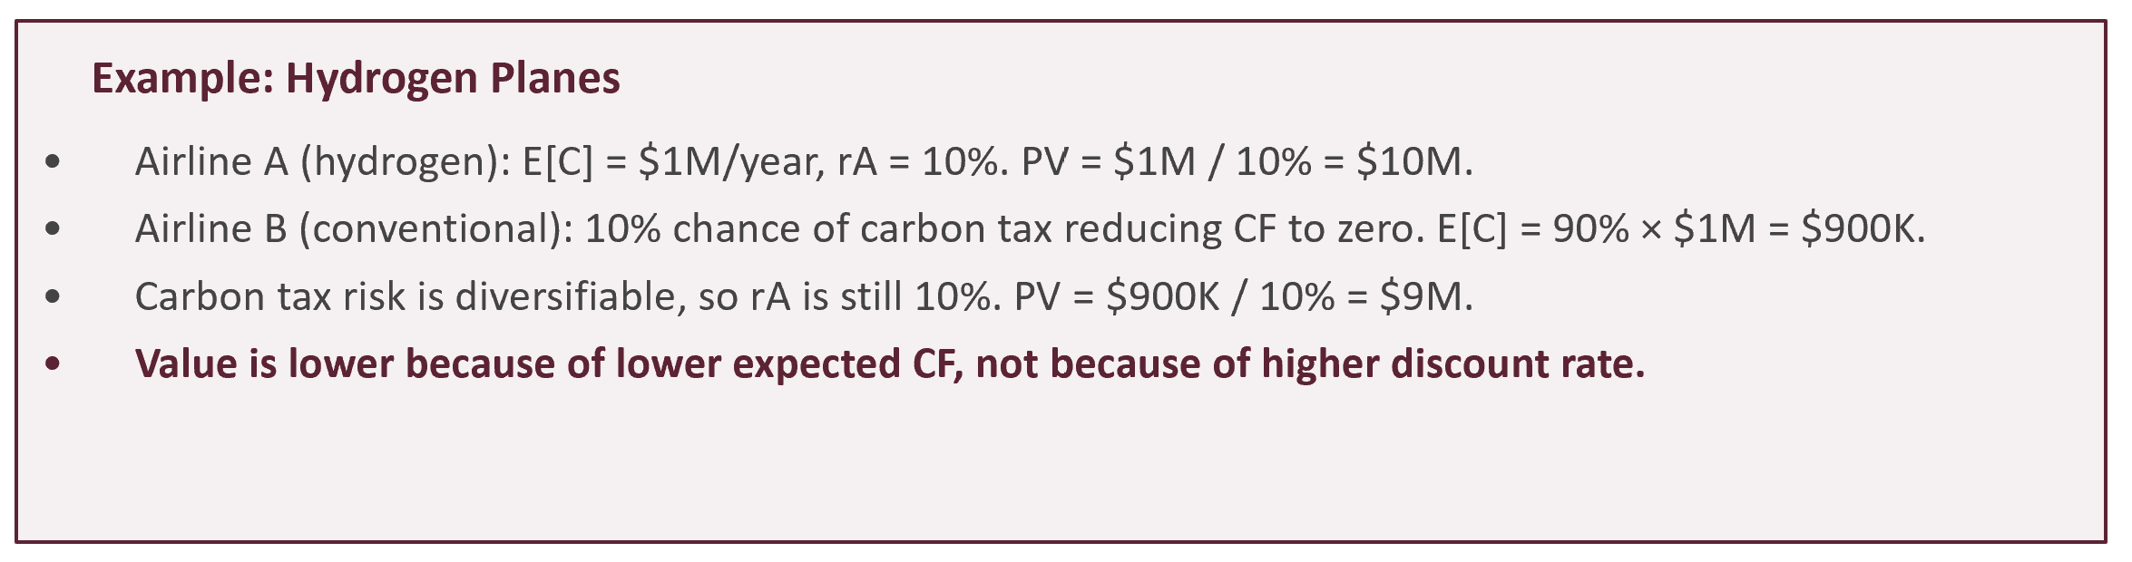
Ignore diversifiable risk

Slide 25
Avoiding fudge factors in discount rates
Fudging the discount rate is tempting because it’s simple—but it’s completely arbitrary.
Downside risk should always be incorporated by reducing expected cash flows, not by adding fudge factors into the discount rate.
In the aforementioned example:
To get the correct value of $9M for Airline B, you'd need to add exactly 1.11% to the discount rate (from 10% to 11.11%). This precision is impossible to guess.
Increasing the discount rate by 10 percentage points gives $1M/20% = $5M (far too low).
Increasing by 10 percent gives $1M/11% = $9.09M (slightly too high).
ESG risks: surveys show that firms commonly adjust discount rates for ESG factors. But many ESG risks are company-specific (diversifiable) and should affect expected cash flows, not the cost of capital.

Slide 26
Q&A
See you guys on Thurs.

